Slide 1
Session 21 : Monte Carlo Methods
Introduction to Monte Carlo Methods
Basis of Monte Carlo
Generating Random Variables
Pseudo-random number generators
Parallel random number generation

Slide 2
Monte Carlo Methods
Have been invented in the context of the development of the atomic bomb in the 1940’s
These are a class of computational algorithms
It can be applied to vast ranges of problems
It is not a statistical tool
Rely on repeated random sampling
Provide generally approximate solutions

Slide 3
Monte Carlo Methods –v1
Monte-Carlo methods generally follow the following steps:
Determine the statistical properties of possible inputs
Generate many sets of possible inputs which follows the above properties
Perform a deterministic calculation with these sets
Analyse statistically the results

Slide 4
Monte Carlo Methods -v2
Set up the predictive model, identifying both the dependent variable to be predicted and the independent variables (also known as the input, risk or predictor variables) that will drive the prediction.
Specify probability distributions of the independent variables. Use historical data and/or the analyst’s subjective judgment to define a range of likely values and assign probability weights for each.
Run simulations repeatedly, generating random values of the independent variables. Do this until enough results are gathered to make up a representative sample of the near infinite number of possible combinations.

Slide 5
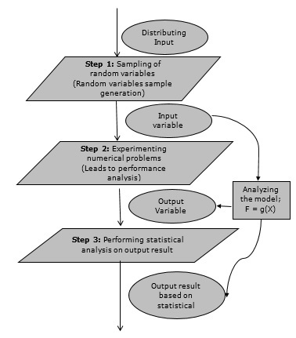
Monte Carlo Method-v3

Slide 6
Monte Carlo Method
There is single definition of Monte Carlo method, it is a general term used for many algorithm following below steps
Repeatedly select many-many random data points
Perform deterministic computation (finding values at that point)
Combine the results

Slide 7
Monte Carlo Method - Important Characteristics
Its output must generate random samples.
Its input distribution must be known.
Its result must be known while performing an experiment.

Slide 8
Monte Carlo Method - Advantages
Easy to implement.
Provides statistical sampling for numerical experiments using the computer.
Provides approximate solution to mathematical problems.
Can be used for both stochastic and deterministic problems.

Slide 9
Generating Random Variables
Normal Distribution - numpy.random.normal
Triangular Distribution - numpy.random.triangular
Uniform Distribution - numpy.random.uniform
Weibull Distribution - numpy.random.weibull

Slide 10
Pseudo-random number generators (PRNG)
It is a mechanism for generating random number on a computer that are indistinguishable from true random numbers
Many application don’t have source of truly random number, such case PRNG is useful
Linear Congruential Generator is most common algorithm
import random
from datetime import datetime
# Passing the current time as the seed value
dt=datetime.now()
random.seed(int(dt.strftime('%Y%m%d%H%M%S%f')))
for i in range(5):
print(random.randint(0, 10), end="\t")

Slide 11
Parallel random number generation
Generating random number using PRNG ( and other ) across multiple processes (local or distributed).
from numpy.random import SeedSequence, default_rng
ss = SeedSequence(12345)
# Spawn off 10 child SeedSequences to pass to child processes.
child_seeds = ss.spawn(10)
streams = [default_rng(s) for s in child_seeds]
grandchildren = child_seeds[0].spawn(4)
grand_streams = [default_rng(s) for s in grandchildren]

Slide 12
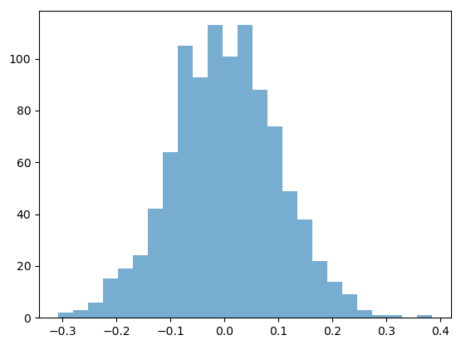
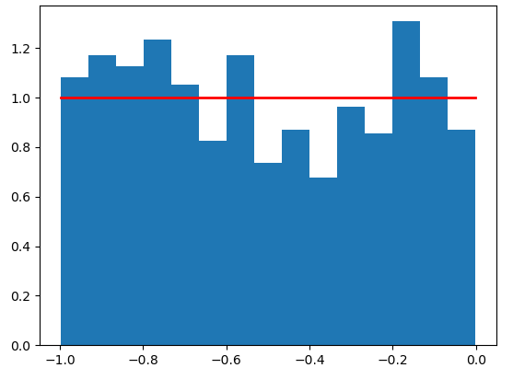
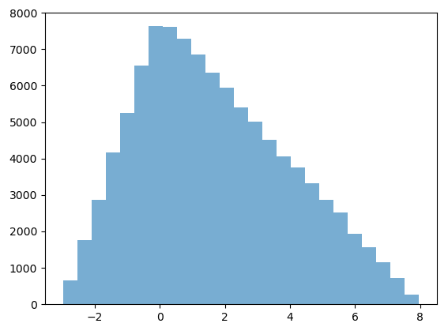
Generating Random Variables
import numpy as np
import matplotlib.pyplot as plt
mu, sigma=0, 0.1 # mean and standard deviation
s = np.random.normal(mu, sigma, 1000)
plt.hist(s, bins=25, density=False, alpha=0.6)
plt.show()
#-------------------------------------------------------------
import numpy.random as rnd
s=np.random.triangular(-3, 0, 8, 100000)
plt.hist(s, bins=25, density=False, alpha=0.6)
plt.show()
#--------------------------------------------------------------
import matplotlib.pyplot as plt
s = np.random.uniform(-1,0,1000)
count, bins, ignored = plt.hist(s, 15, density=True)
plt.plot(bins, np.ones_like(bins), linewidth=2, color='r')
plt.show()

Slide 13
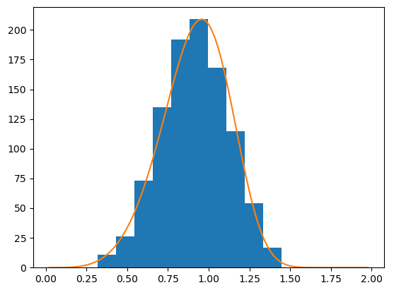
Generating Random Variables
a = 5. # shape
s = np.random.weibull(a, 1000)
import matplotlib.pyplot as plt
x = np.arange(1,100.)/50.
def weib(x,n,a):
return (a / n) * (x / n)**(a - 1) * np.exp(-(x / n)**a)
count, bins, ignored = plt.hist(np.random.weibull(5.,1000))
x = np.arange(1,100.)/50.
scale = count.max()/weib(x, 1., 5.).max()
plt.plot(x, weib(x, 1., 5.)*scale)
plt.show()

Slide 14
Session 22
Monte Carlo methods for numerical integration
Monte Carlo methods for simulation
Applications, Examples

Slide 15
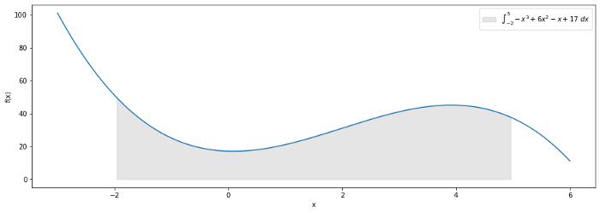

Monte Carlo methods for numerical integration
Lets take a function for integration
$F=\int_{a}^{b}{f\left(x\right)dx}$ $f\left(x\right)=x^{3}+6x−x+17$ => a=-2, b=5
b-a

Slide 16
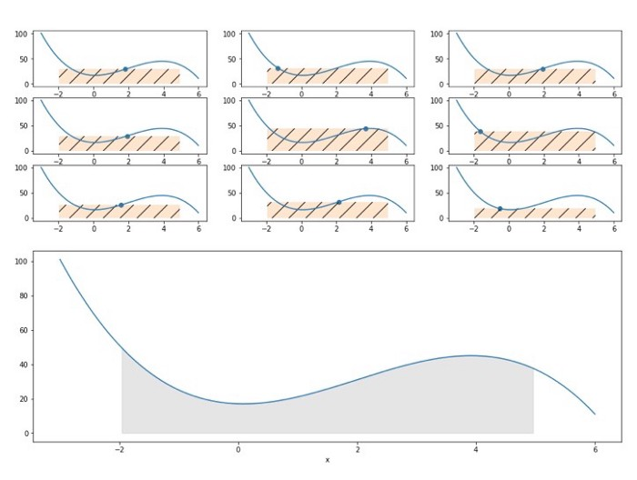
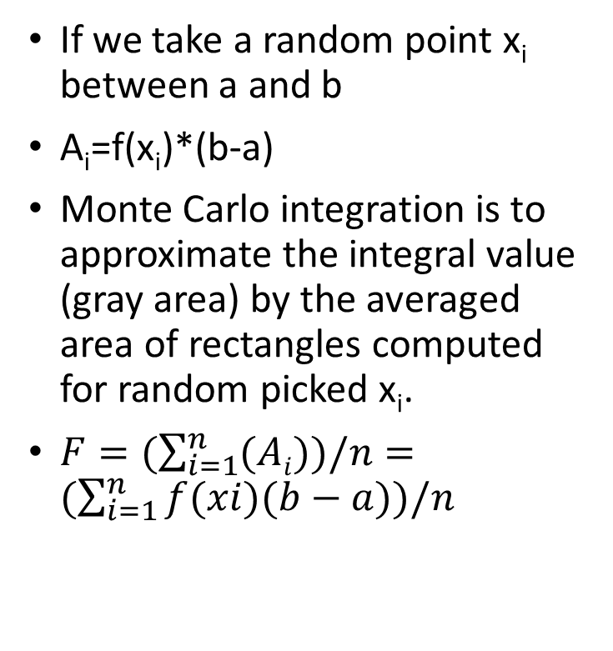
Monte Carlo methods for numerical integration
If we take a random point x_{i} between a and b
A_{i}=f(x_{i})*(b-a)
Monte Carlo integration is to approximate the integral value (gray area) by the averaged area of rectangles computed for random picked x_{i}.
$F=(\sum_{i=1}^{n}{(Ai}))/n=(\sum_{i=1}^{n}{f(xi)(b−a))/n}$
b-a

Slide 17
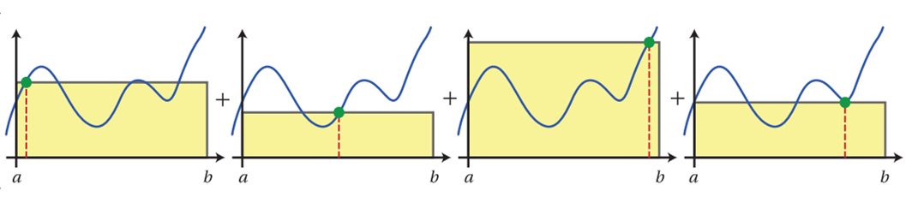

Monte Carlo methods for numerical integration
$$F=(\sum_{i=1}^{n}{(Ai}))/n=(\sum_{i=1}^{n}{f(xi)(b−a))/n}$$

Slide 18

Monte Carlo methods for numerical integration
$f\left(x\right)=x^{3}+6x−x+17$ Between Limit a=-2, b=5
import numpy as np
# function
def f(x):
return 𝑥*𝑥*𝑥+6*𝑥-𝑥+17
# Random Points
rn= np.random.uniform(-2, 5, 1000)
# Points on a Curve
xi=[]
for i in rn:
xi.append(f(i))
# Area of each reactangle
Area=[]
for h in xi:
Area.append(abs(h)*7)
# Avg area of all rectangle
np.mean(Area)

Slide 19
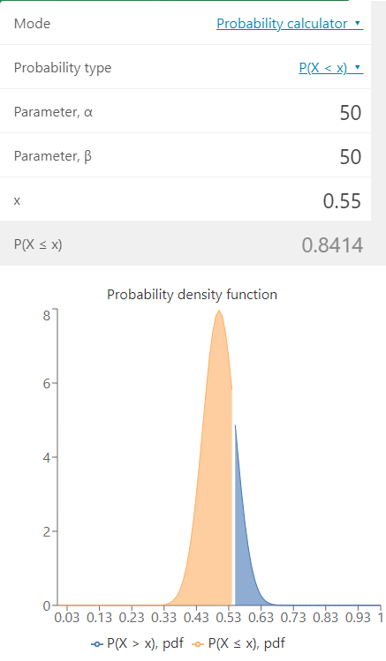
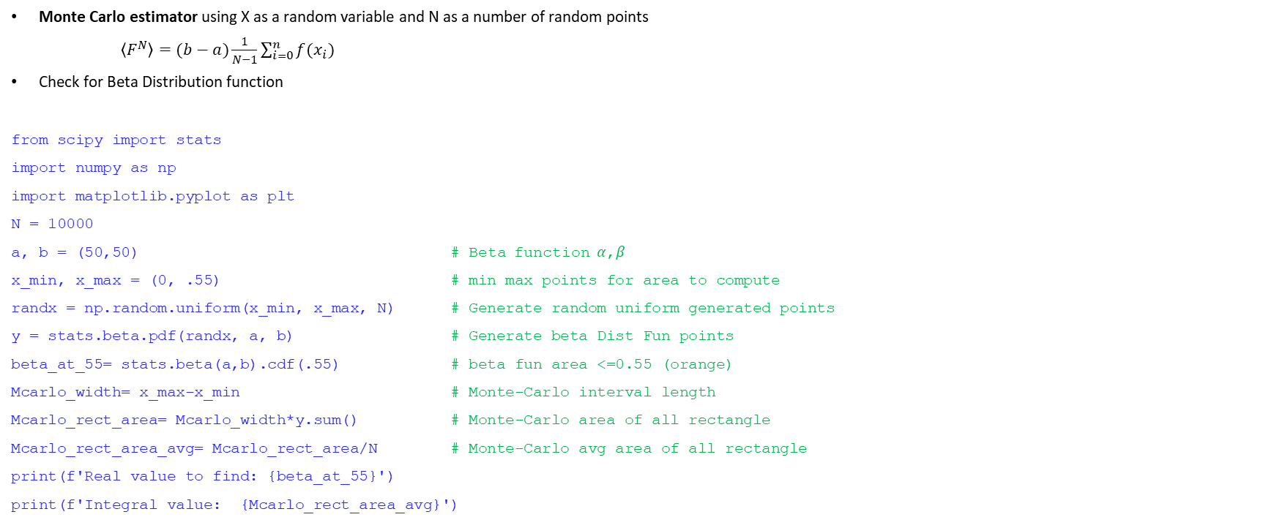
Monte Carlo methods for numerical integration
Monte Carlo estimator using X as a random variable and N as a number of random points
$\left\langle F^{N}\right\rangle =(b−a)\frac{1}{N−1}\sum_{i=0}^{n}{f(x_{i}) }$
Check for Beta Distribution function
from scipy import stats
import numpy as np
import matplotlib.pyplot as plt
N = 10000
a, b = (50,50) # Beta function 𝛼,𝛽
x_min, x_max = (0, .55) # min max points for area to compute
randx = np.random.uniform(x_min, x_max, N) # Generate random uniform generated points
y = stats.beta.pdf(randx, a, b) # Generate beta Dist Fun points
beta_at_55= stats.beta(a,b).cdf(.55) # beta fun area <=0.55 (orange)
Mcarlo_width= x_max-x_min # Monte-Carlo interval length
Mcarlo_rect_area= Mcarlo_width*y.sum() # Monte-Carlo area of all rectangle
Mcarlo_rect_area_avg= Mcarlo_rect_area/N # Monte-Carlo avg area of all rectangle
print(f'Real value to find: {beta_at_55}')
print(f'Integral value: {Mcarlo_rect_area_avg}')

Slide 20
Monte Carlo Simulation
A Monte Carlo simulation is used to model the probability of different outcomes in a process that cannot easily be predicted due to the intervention of random variables.
It is a technique used to understand the impact of risk and uncertainty.
A Monte Carlo simulation is used to tackle a range of problems in many fields including investing, business, physics, and engineering.
A Monte Carlo simulation is a model used to predict the probability of a variety of outcomes when the potential for random variables is present.
Monte Carlo simulations help to explain the impact of risk and uncertainty in prediction and forecasting models.
A Monte Carlo simulation requires assigning multiple values to an uncertain variable to achieve multiple results and then averaging the results to obtain an estimate.
Monte Carlo simulations assume perfectly efficient markets.

Slide 21
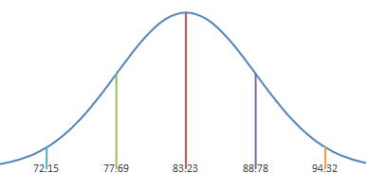
Monte Carlo Simulation -1
Let’s assume we have a process constructed from 3 stages (X1, X2, X3). Each one has an average duration (5, 10 and 15 minutes) which vary following the normal distribution and we know their variance (all 1 minute)
=> We want to know what is the probability that the process will exceed 34 minutes?
X=N(µ,𝜎²)
X₁=N(5,1)
X₂=N(10,1)
X₃=N(15,1)
Y=N(30,3)

Slide 22
Monte Carlo Simulation - 1
Define relationship
Y=X₁+X₂+X₃
Lets pass 100000 sample from all stages
As a process is normally distributed, generate ND sample point for all three stages.
Check the probability that sample will take more than 34 min.

Slide 23
Monte Carlo Simulation - 1
import numpy.random as rnd
import numpy as np
import matplotlib.pyplot as plt
def mc_normal(mean, std_dev, samples):
results = []
for _ in range(samples):
results.append(rnd.normal(mean, std_dev))
return np.array(results)
# configuration
s = 100000 # number of samples
upper_limit = 34 # upper limit from specification
# components
component_1 = mc_normal(5,1,s)
component_2 = mc_normal(10,1,s)
component_3 = mc_normal(15,1,s)
# relationships
total = component_1 + component_2 + component_3
# success conditions
probability = np.sum(total > upper_limit)/len(total)*100
print("Probability of exceeding the time limit: ", round(probability, 3), "%")
count, bins, ignored = plt.hist(total, 30, density=True,color='skyblue')
plt.vlines(34,count.min(),count.max(),color='r',label="34 Minute")
plt.legend() ; plt.show()
Probability of exceeding the time limit: 0.997 %

Slide 24

Monte Carlo Simulation - 1
Y=N(30,3)
z-score => $Z=\frac{x−μ}{δ}=\frac{34−30}{\sqrt{3}}≈2.31$
P-value we read now from the z-score table
1-p=1-0.9896=0.0104=1.04%

Slide 25
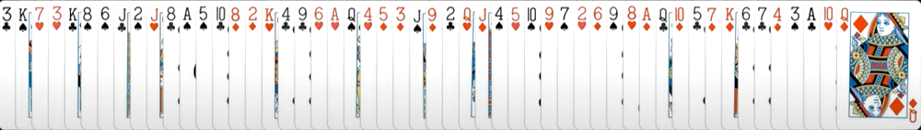

Monte Carlo Simulation - 2
What is a probability that at least 2 Kings will appear next to each other in the shuffled desk

Slide 26
Monte Carlo Simulation - 2
org_deck=[
'1S','2S','3S','4S','5S','6S','7S','8S','9S','10S','JS','QS','KS',
'1H','2H','3H','4H','5H','6H','7H','8H','9H','10H','JH','QH','KH',
'1C','2C','3C','4C','5C','6C','7C','8C','9C','10C','JC','QC','KC',
'1D','2D','3D','4D','5D','6D','7D','8D','9D','10D','JD','QD','KD'
]
Function MonteCarlo(number_of_sample):
count=0
loop over number_of_sample :
deck=org_deck.copy()
np.random.shuffle(deck) #Shuffle a deck
if kingking(deck)
count=count+1
calculate % value
Function kingking(deck):
if K & K are adjusant:
return True
Call MonteCarlo(number_of_sample)

Slide 27
Monte Carlo Simulation - 2
import numpy as np
import copy
import matplotlib.pyplot as plt
org_deck=[
'1S','2S','3S','4S','5S','6S','7S','8S','9S','10S','JS','QS','KS',
'1H','2H','3H','4H','5H','6H','7H','8H','9H','10H','JH','QH','KH',
'1C','2C','3C','4C','5C','6C','7C','8C','9C','10C','JC','QC','KC',
'1D','2D','3D','4D','5D','6D','7D','8D','9D','10D','JD','QD','KD'
]
def kingking(deck):
for i in range(len(deck)-1):
if deck[i][0]=='K' and deck[i+1][0]=='K’: # check if there is King-King combination
return True
def MonteCarlo(n):
count=0.0
for i in range(n):
deck= copy.deepcopy(org_deck)
np.random.shuffle(deck) # Shuffle a deck
if kingking(deck): # check if there is King-King combination
count = count +1 # if found then increase a count
print(count/n*100) # Get a success %
return count/n*100
#Simulate
result=[]
for i in range(1,7):
result.append(MonteCarlo(10**i))
# Actual probability value = 21.7376%
plt.xscale('log')
plt.plot([10**i for i in range(1,7)],result)
plt.scatter([10**i for i in range(1,7)],result)

Slide 28
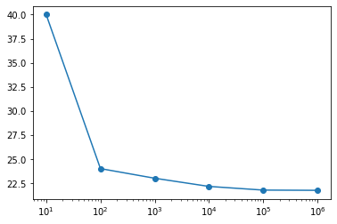
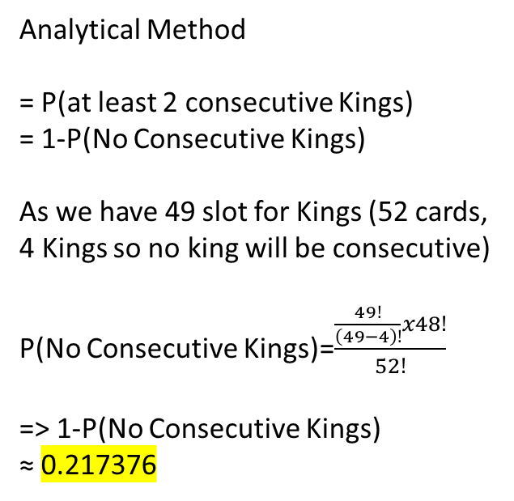
Monte Carlo Simulation - 2
Analytical Method
= P(at least 2 consecutive Kings)
= 1-P(No Consecutive Kings)
As we have 49 slot for Kings (52 cards, 4 Kings so no king will be consecutive)
P(No Consecutive Kings)=$\frac{\frac{49!}{\left(49−4\right)!}x48!}{52!}$
=> 1-P(No Consecutive Kings)
≈ 0.217376

Slide 29
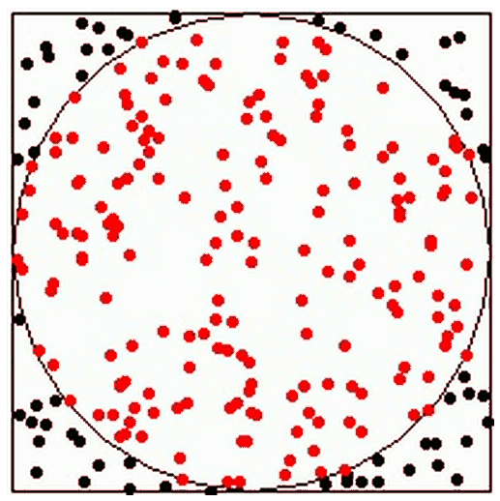


Monte Carlo Simulation - 3
Estimating the value of pi
Area of Circle = πR²= π
Area of Square = 2²=4
Ratio of Area =$\frac{\text{π}}{4}$
R=1
-1
1
Dots in Circle = n
Dots in Square = N
Ratio = $\frac{\text{n}}{N}=\frac{\text{π}}{4}$ =>$\text{π}=4∗\frac{\text{n}}{N}$
2

Slide 30
Monte Carlo Simulation - 3
import numpy
import matplotlib.pyplot as plt
N = 1000
inside = []
for i in range(N):
x = numpy.random.uniform(-1, 1) # Uniform points over -1 to 1 x direction
y = numpy.random.uniform(-1, 1) # Uniform points over -1 to 1 y direction
if numpy.sqrt(x**2 + y**2) < 1: # compare point's distance from Centre using X^2 +Y^2 = r^2
inside.append((x, y))
plt.figure(figsize=(6, 6))
plt.scatter([x[0] for x in inside], [y[1] for y in inside], marker=".", alpha=0.5)
print("Value of π : ",4 * len(inside)/float(N))

Slide 31
Monte Carlo Simulation - 4
Sensitivity analysis methods
Sensitivity analysis using slopes :
study the input-output functions expressed as slopes.
calculate how many units the output will change by when increasing one unit of the input.
studying the derivatives or partial derivatives
how many times the output changes with a 10% increase in input.
Direct methods :
relationships with purely mathematical methods.
Variance-based sensitivity analysis :
study the amount of variation in the output and how it can be explained by different inputs
we can determine if the output can be stabilized by better controlling the inputs without having to know the exact input-output relationships

Slide 32
Monte Carlo Simulation - 4
import numpy as np
import math
from sensitivity import SensitivityAnalyzer
def my_func(x_1, x_2,x_3):
return math.log(x_1/ x_2 + x_3)
x_1=np.arange(10, 100, 10)
x_2=np.arange(1, 10, 1)
x_3=np.arange(1, 10, 1)
sa_dict = {'x_1':x_1.tolist(),'x_2':x_2.tolist(),'x_3':x_3.tolist()}
sa_model = SensitivityAnalyzer(sa_dict, my_func)
plot = sa_model.plot()
styled_df = sa_model.styled_dfs()

Slide 33
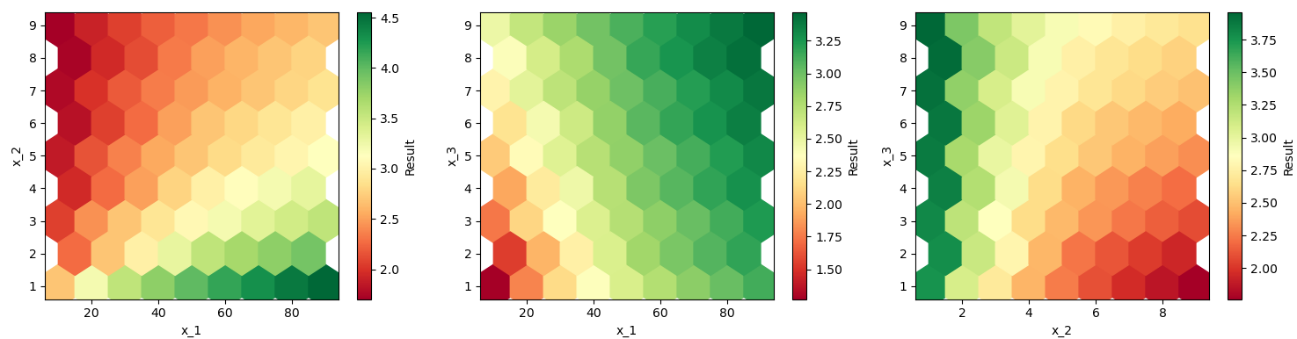
Monte Carlo Simulation - 4
From third graph
for low values of x2, the x3 variable seems irrelevant. -> Blue
As the values of x2 increase, output is changing with increasing x_3
Conclusion:
System is not sensitive when X2 is very low irrespective to X3 chagnes

